Slide 1
Administrative Burden and SNAP Work Requirements Prof. Mark Shepard Harvard Kennedy School Special Guests: Elizabeth Linos, Kelsey Pukelis SUP-110: Poverty and Public Policy Week 6, Food & Nutrition Programs

Slide 2
Outline
Administrative Burden Overview
Work Requirements Debate
Gray et al (2023, AEJ Policy) evidence
Broader debate work requirements in SNAP and beyond
Q&A and Discussion

Slide 3
Work requirements debate
Section 2

Slide 4
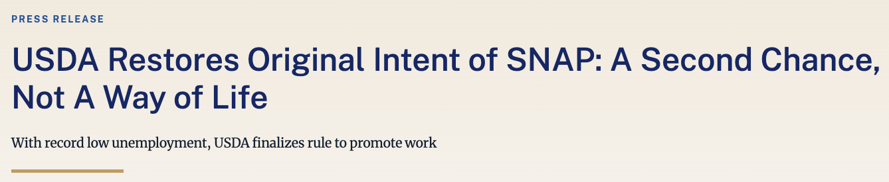
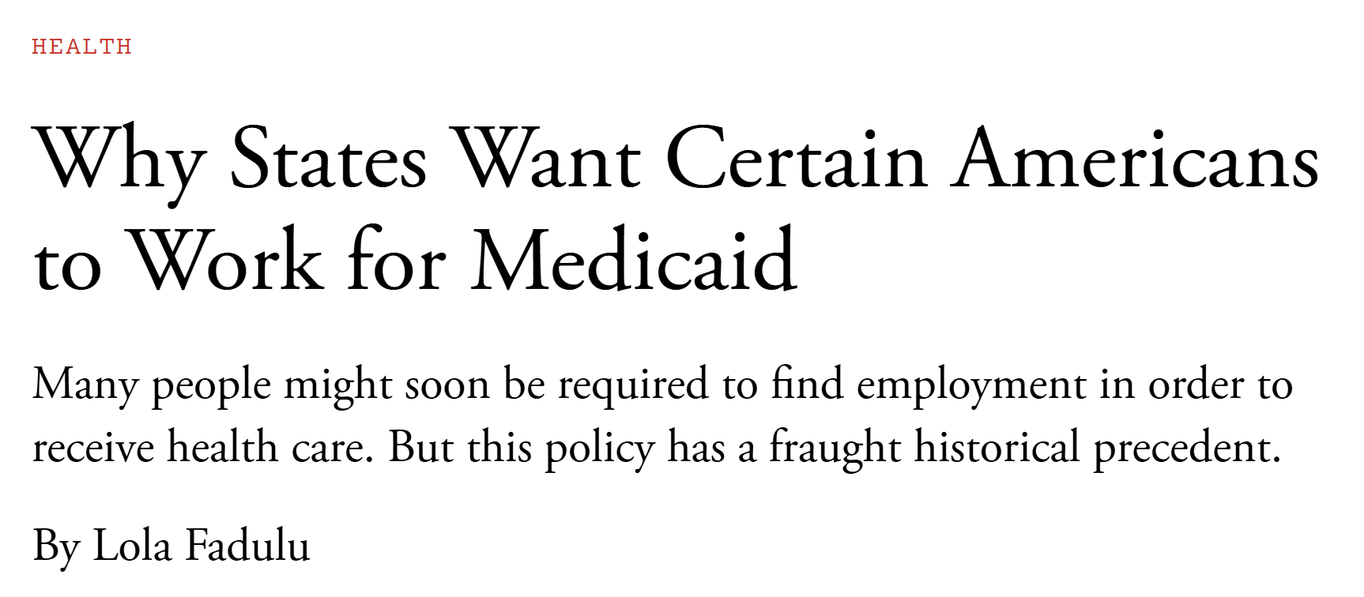
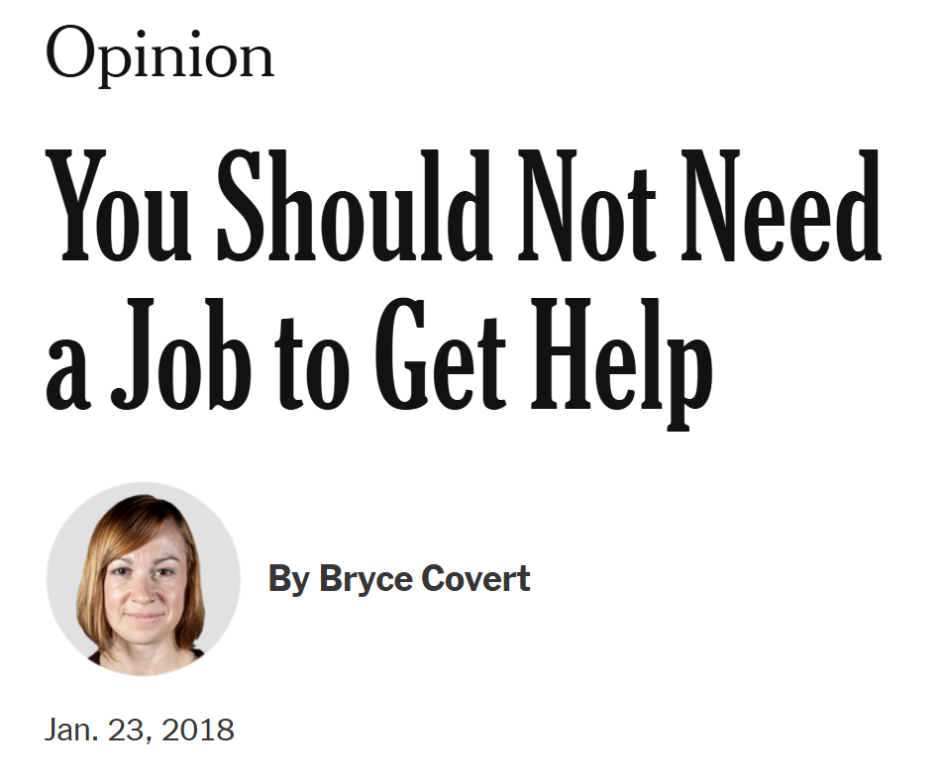
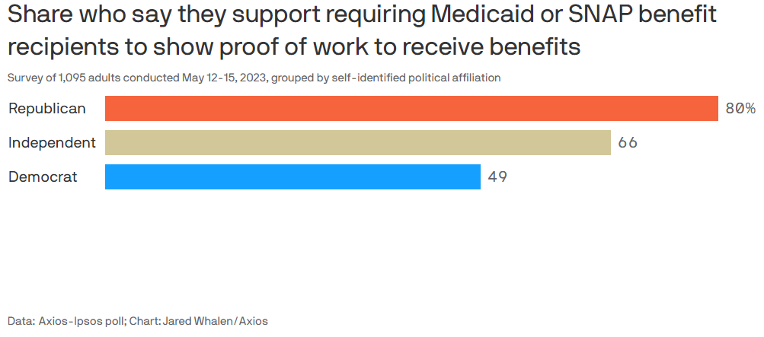
Work Requirements Debate

Slide 5
SNAP “ABAWD” work requirements
Who: “Able-Bodied Adults Without Dependents” (ABAWDs)
Aged 18-54 & deemed able to work
What: Limit to 3 months of SNAP per 3 years when not engaged in “work activity”
Work activity is ≥80 hrs/month of work, job training, or community service
Where: Nationwide, unless waived in areas w/ high unemployment
Role of federalism: states must apply to federal gov’t to apply local waivers
When: since 1996 welfare reform & during “non-recessions”
Waived broadly during the Great Recession & COVID-19 pandemic
No automatic rule

Slide 6
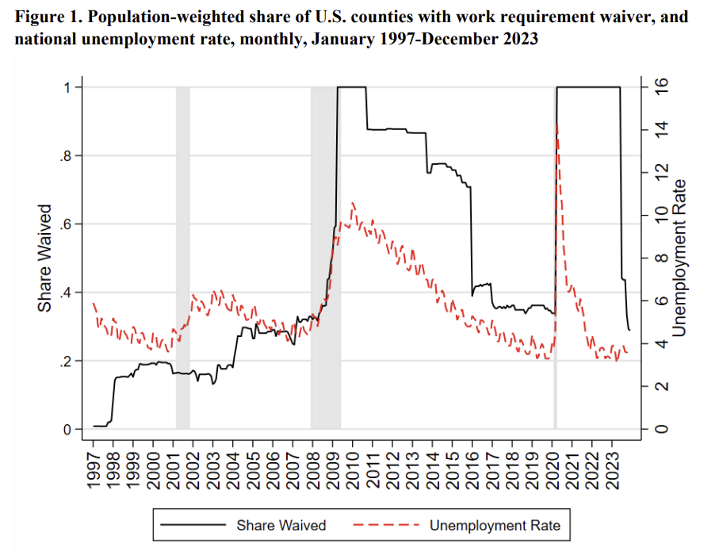
Share of counties with a work requirement waiver
Link to Paper

Slide 7
Who is subject to SNAP work requirements?
ABAWDs comprise approximately 9.3% of all SNAP recipients (Proposed Rule)
ABAWDs have little access to other safety net benefits
No children → Not eligible for WIC or TANF
Smaller EITC credit
Medicaid availability depends on state ACA expansions
May not work enough to qualify for UI
Compared to other SNAP participants, ABAWDs are:
more likely to be homeless & have mental & physical limitations (Wheaton et al. 2021)
less likely to have earned and unearned income (Gray et al. 2023)
Notes:
Average affected household size: 1.32 people
Average benefit size for households exiting: $189 per month
(From our paper)

Slide 8
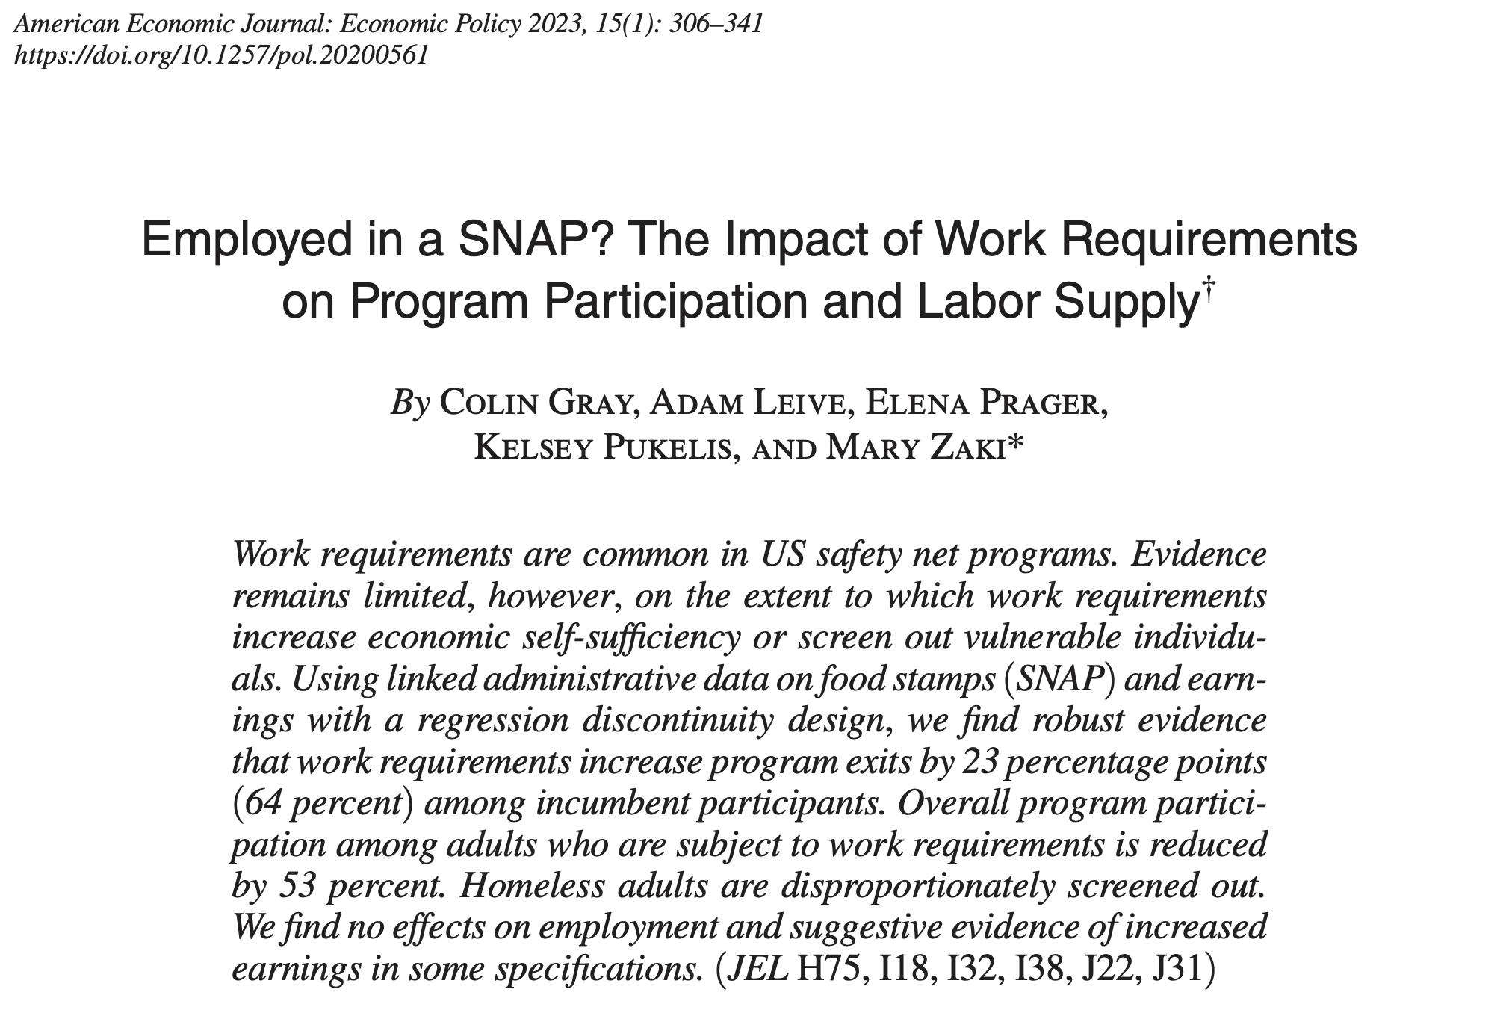
Some Evidence: Gray et al. (2023)
Source: Gray et al. (2023)

Slide 9
Effects of SNAP Work Requirements (Gray et al. 2023)
Regression discontinuity, comparing adults above & below age 50
Employment & earnings
No effects of work requirements on work
Suggestive evidence that those close to meeting 80 hrs /month increase hours
We can rule out that avg. earnings increased more than $28 / person / month
SNAP participation
SNAP participation ↓ 53 percent among those subject to work requirements
Larger reductions among:
individuals with a history of homelessness
those without prior earned income
Smaller reductions among those with a history of disability (exemptions)

Slide 10
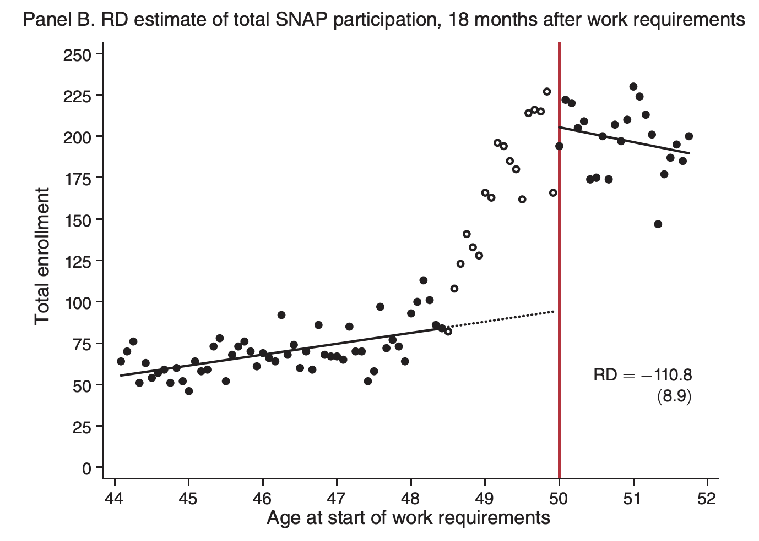
Main Estimates on SNAP Participation (“Donut RD”)
RD estimate: 53% decrease in enrollment
Always exposed to work requirement
Partly exposed
Never exposed
Source: Gray et al. (2023)

Slide 11
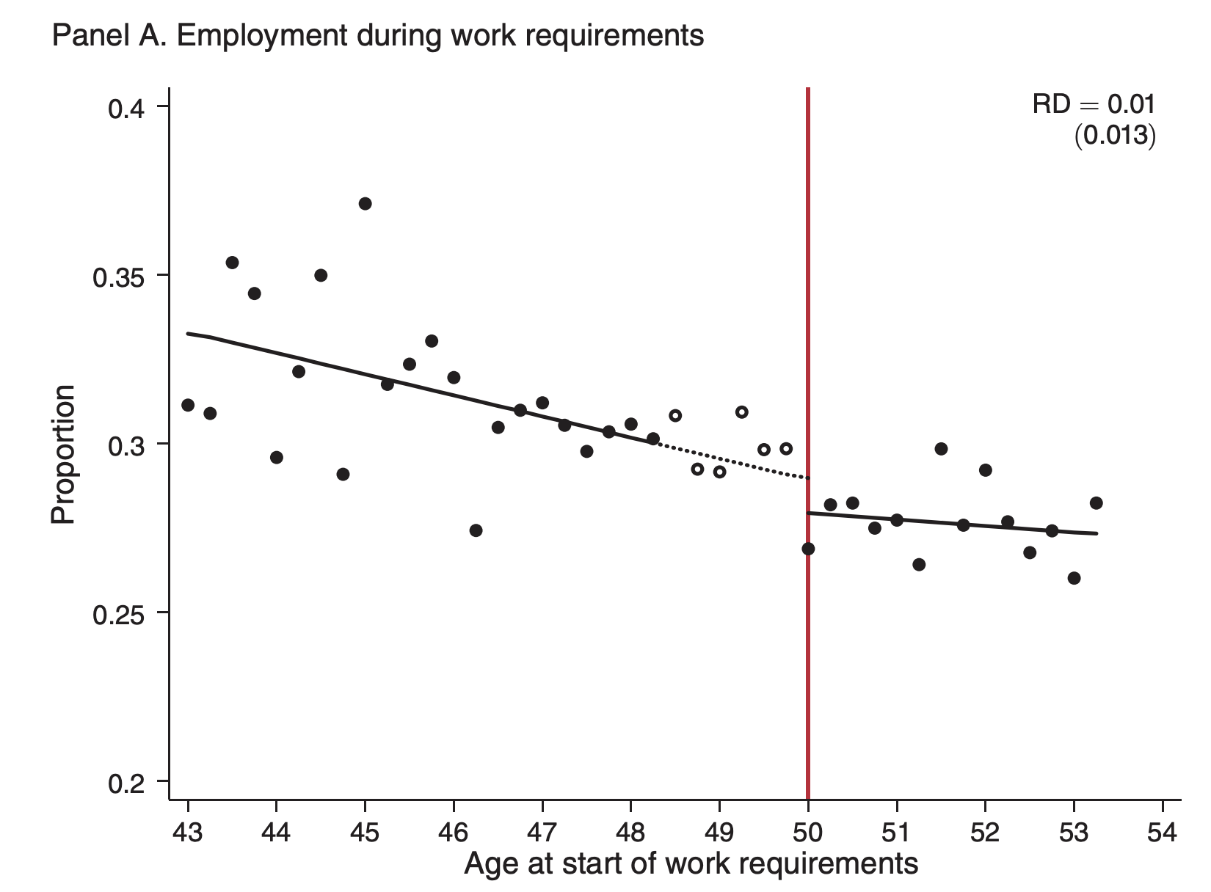
Main RD Estimates on Employment Rate
RD estimate: No impact
Source: Gray et al. (2023)

Slide 12
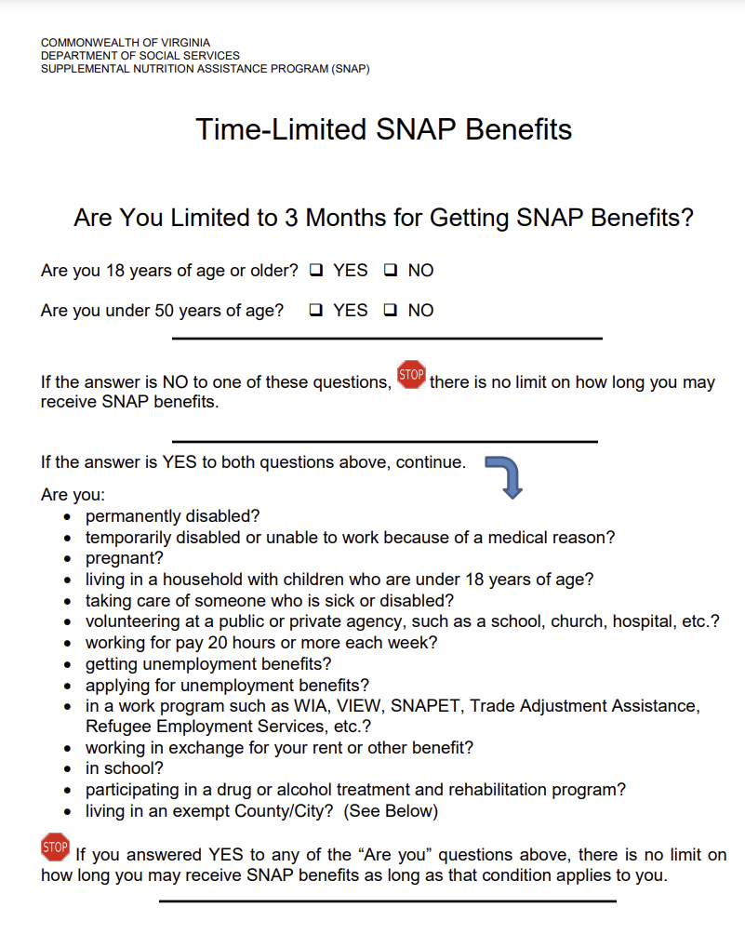
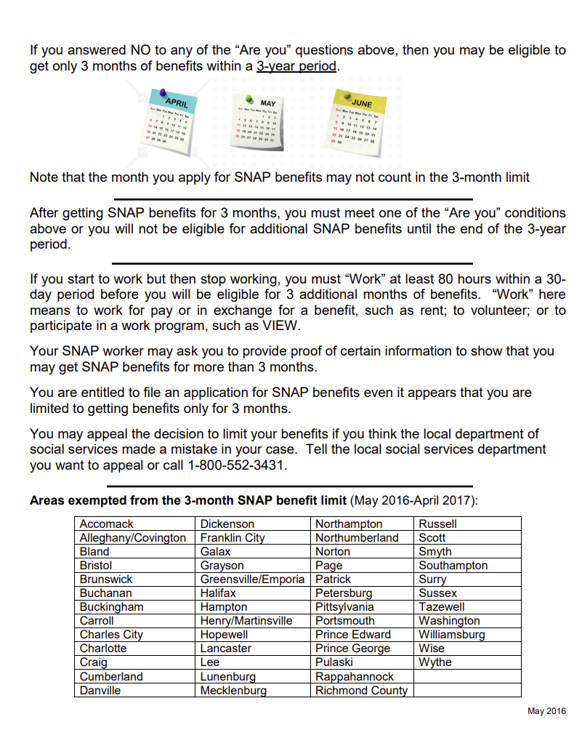
Work requirements & time limits flyer

Slide 13






Work requirements exemptions
New exemptions as of 2023: veterans, people experiencing homelessness, & former foster youth under 24

Slide 14
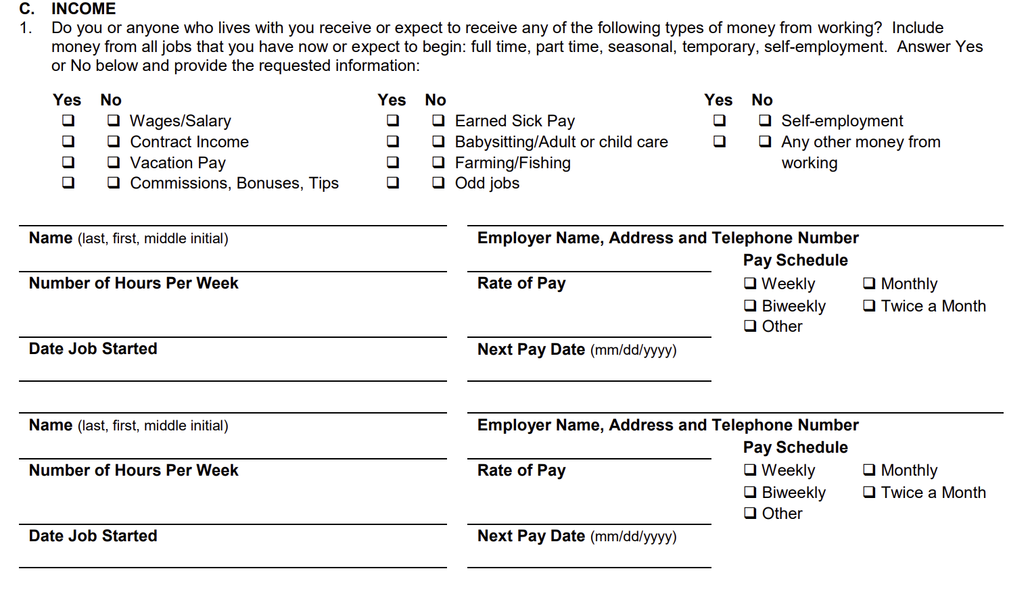
Documenting earned income
+ provide documentation of hours worked
Virginia SNAP recert. form

Slide 15
Navigating work requirements
If a seeking an exemption:
Learn about possible exemptions & identify a possible category
Provide documentation at application & recertification
If subject to the work requirements:
Fulfill work requirements
Provide documentation of hours worked (e.g. pay stubs)
Face more frequent recertifications (e.g. 4 or 6 vs. 12 months)
Recerts lead to disenrollment (Gray 2019; Homonoff & Somerville 2021)

Slide 16
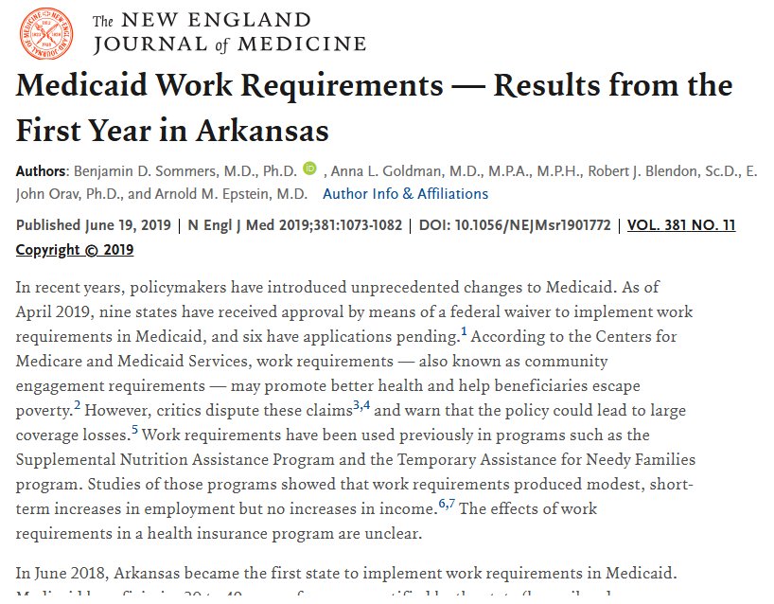
Work requirements or “Paperwork” requirements?
Gray et al. study cannot distinguish mechanisms b/n work vs. paperwork hassles in SNAP
No difference in disenrollment effects for 2 vs. 1 recerts, suggesting the extra recert does not drive our results (Gray et al. 2023)
Additional evidence: Medicaid work requirements in Arkansas
95% of people were already employed or qualified for an exemption…
but work requirements ↓ enrollment by 12 pp (Sommers et al. 2019)
About one-third of those who lost coverage were unaware of the new requirements
Source: Sommers et al. (NEJM, 2019)

Slide 17
Minimizing admin burden in work requirements
Question: How can work requirements (& exemptions) be implemented in a way that minimizes admin burden?

Slide 18
Minimizing admin burden in work requirements
Question: How can work requirements (& exemptions) be implemented in a way that minimizes admin burden?
Some ideas:
Link to admin data sources to identify & screen individuals for exemptions & work
Simplify rules to align with info available in admin data
E.g. “Persons…earning at least the equivalent of the federal minimum wage multiplied by 30 hours.”
Require & train agency staff to screen (orally) for exemptions
Screening requirements included in 2023 Proposed Rule → improve implementation consistency across states
Streamline connections to employment & training programs
But be wary of additional requirements (Cook & East 2024) + barriers to work
+ support & build out quality employment & training programs

Slide 19
Minimizing admin burden through auto-enrollment
“Streamlined Certification” in Summer EBT
Administrators use state administrative data to assess children’s eligibility
Lists of children eligible for free & reduced-priced school meals (from apps)
SNAP
TANF, Homeless, Foster Care, etc.
Medicaid
Households can still submit applications to determine eligibility
States identify eligible children across sources and remove duplicates
Automatically enroll eligible children by mailing voucher cards
Demonstrates that “streamlined” enrollment is possible!
Notes:
Some states also use TANF and FDPIR records.

Slide 20
Minimizing admin burden in SNAP
What do you see as ways to reduce admin burden in SNAP more broadly?

Slide 21
Minimizing admin burden in SNAP
What do you see as ways to reduce admin burden in SNAP more broadly?
Some ideas (non-exhaustive):
Improving implementation of call centers (Wu & Meyer 2023)
Addressing fear (Alsan & Yang 2024)

